Slide 1
Capstone Project - The Battle of Neighborhoods
Applied Data Science Capstone
Kumud Kharel

Slide 2
Introduction
The purpose of this Capstone Project is to help people in exploring better facilities around their neighborhood
This Capstone Project aim to create an analysis of features for a people migrating to Scarborough to search a best neighborhood as a comparative analysis between neighborhoods

Slide 3
Synopsis
Problem Description
Suggest a better neighborhood in a new city for the person who are shifting there. Social presence in society in terms of like minded people. Connectivity to the airport, bus stand, city center, markets and other daily needs things nearby.
Sorted list of house in terms of housing prices in a ascending or descending order Sorted list of schools in terms of location, fees, rating and reviews

Slide 4
Synopsis
Part 2: Data We Need
Data Link: https://en.wikipedia.org/wiki/List_of_postal_codes_of_Canada:_M
Foursquare API Data

Slide 5
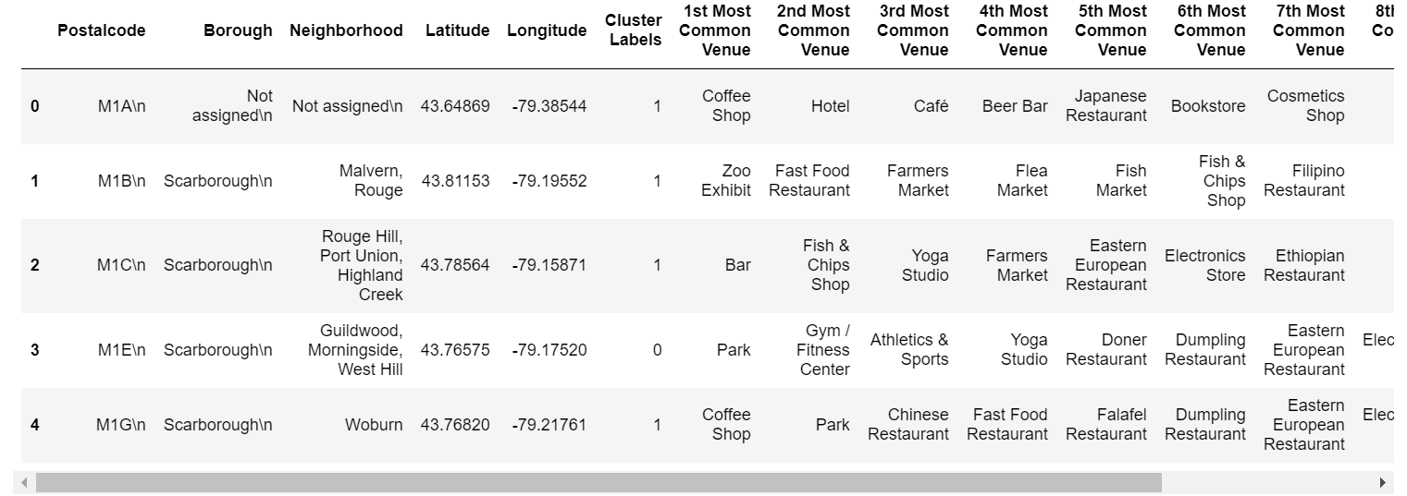
Main Article
Part 1: Using K-Means Clustering Approach

Slide 6
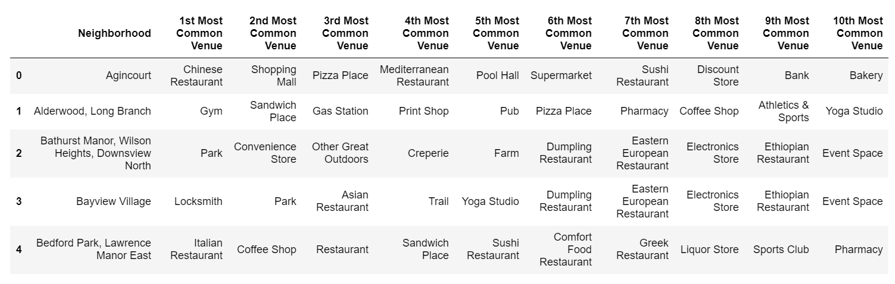
Main Article
Part 1: Identifying Postal Codes (and then Neighborhoods) in "Scarborough"

Slide 7
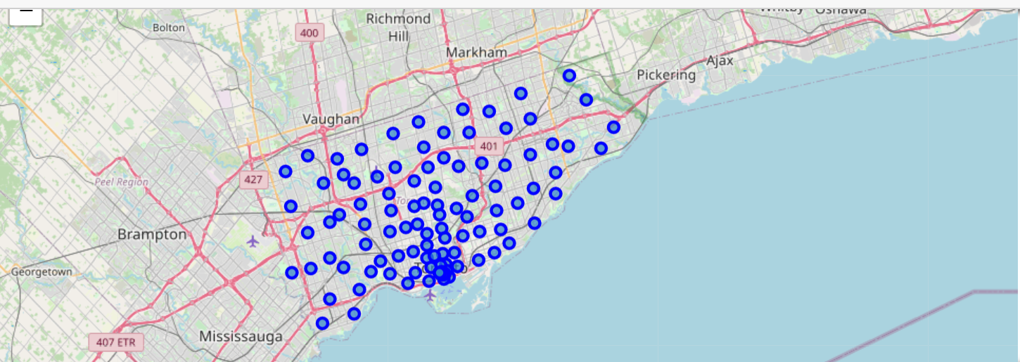
Main Article
Part 1: Map of "Scarborough"

Slide 8
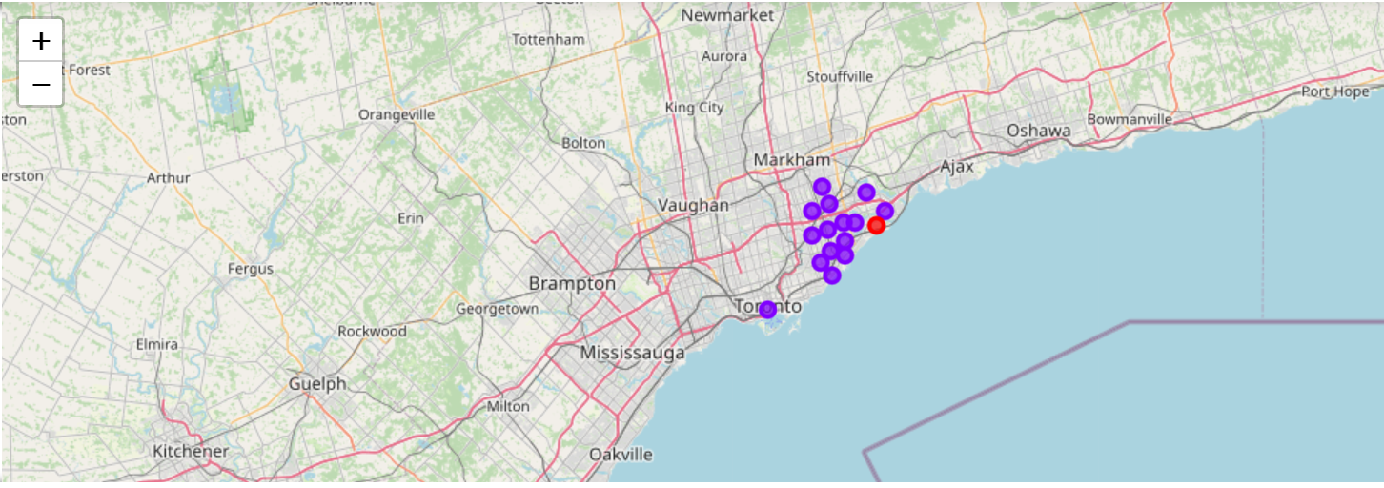
Result Section
Part 1: Map of Clusters in Scarborough

Slide 9
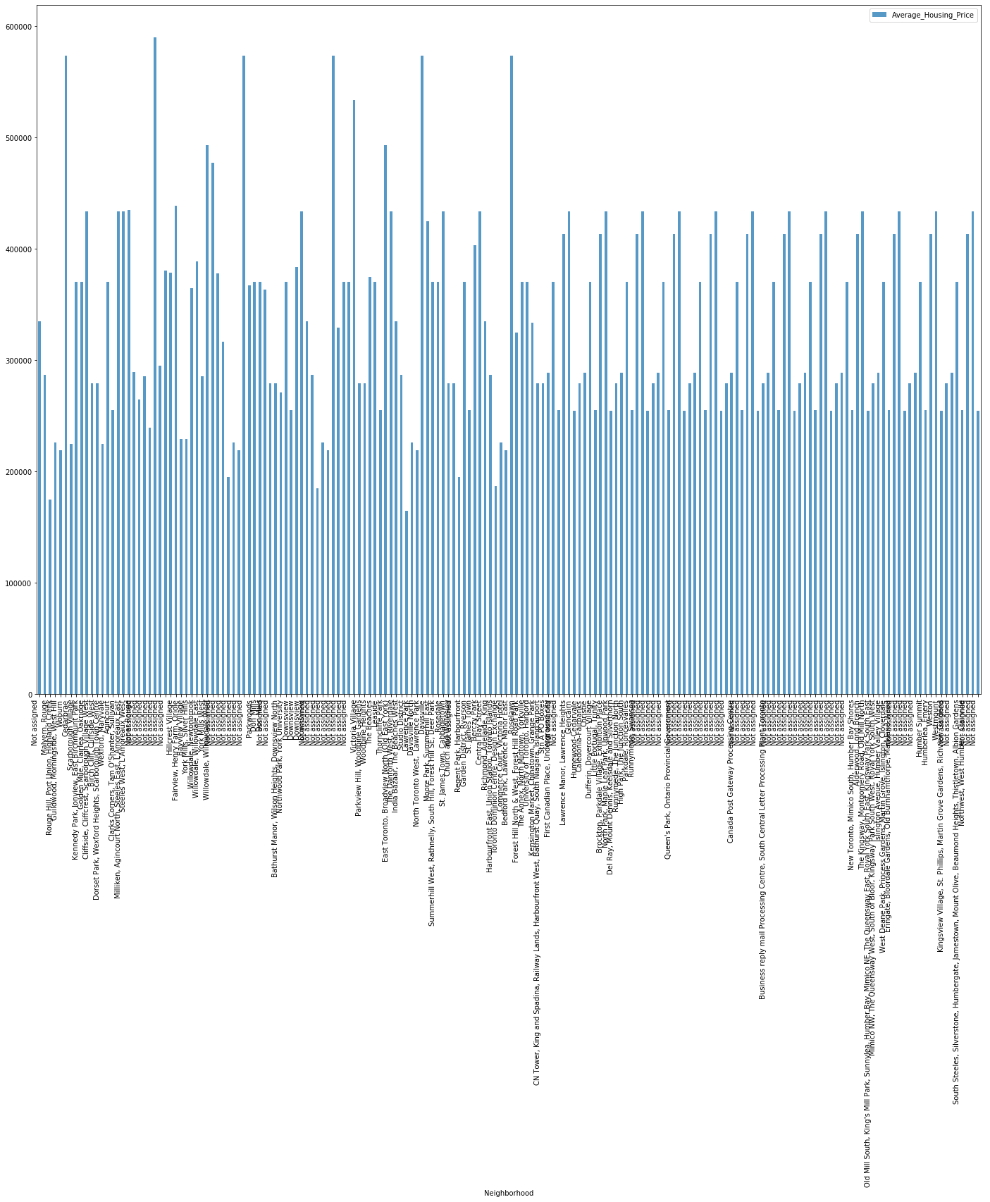
Result Section
Part 1: Average Housing Price by Clusters in Scarborough

Slide 10
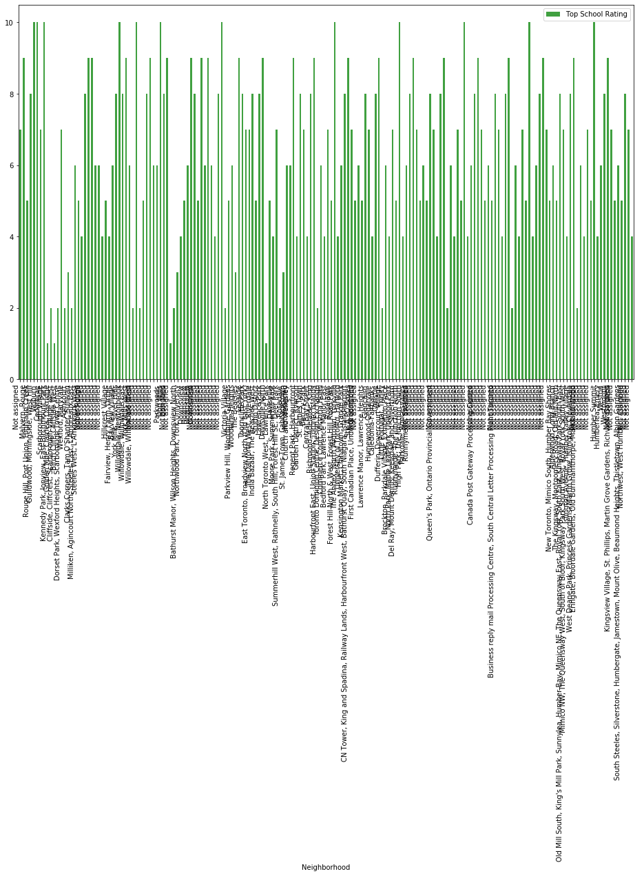
Result Section
Part 1: School Ratings by Clusters in Scarborough

Slide 11
Conclusion Section
In this Capstone project, using k-means cluster algorithm I separated the neighborhood into 10(Ten) different clusters and for 180 different latitude and longitude from dataset, which have very-similar neighborhoods around them. Using the charts above results presented to a particular neighborhood based on average house prices and school rating have been made.

Slide 12
THANK YOU

